Slide 1
Center of Excellence
Project
Presentation
On
Quizzer
( A spaced repetition based flashcard web app )
‹#›

Slide 2
Presented By
Nitish Kumar Mahto | 18ERECS047
Anshuman Singh | 18ERECS011
Himanshu Singh | 18ERECS025
Chandra Vijay Kumawat | 18ERECS017
Presented To
Innovation and Incubation Center of Excellence Committee
Department of Computer Science and Engineering
Project Advisior
Mr. Dinesh Swami
HOD, CSE
‹#›

Slide 3
Project Proposal
To make an open source flashcard app with spaced repetition feature where it takes difficulty of card from user
GUI rich web app
Make it to hold more assets like images, videos, notes etc.
Email the cards to user if he forget to revise cards on due date
Provide a detailed overview of deck learning
Import flashcards from csv files (custom separator)
‹#›

Slide 4
Technologies required
HTML
CSS
JS
Django (Fromework for backend)
MongoDB (Database)
AI (for adaptive revision to be impleamented in V3)
Python3 (For programming main logic)
‹#›

Slide 5
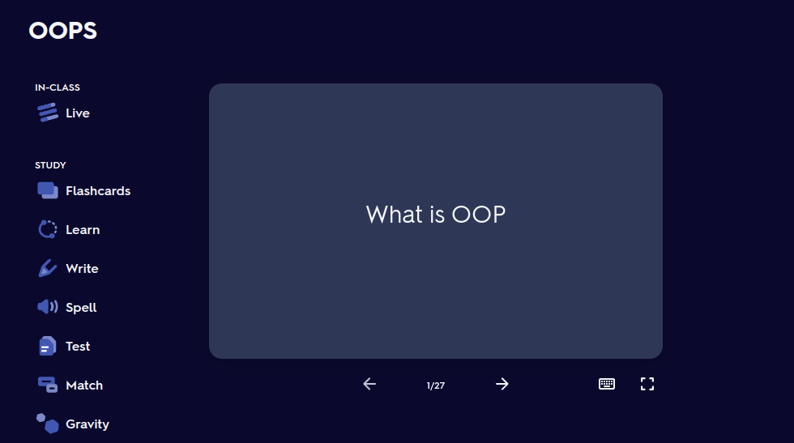
‹#›

Slide 6
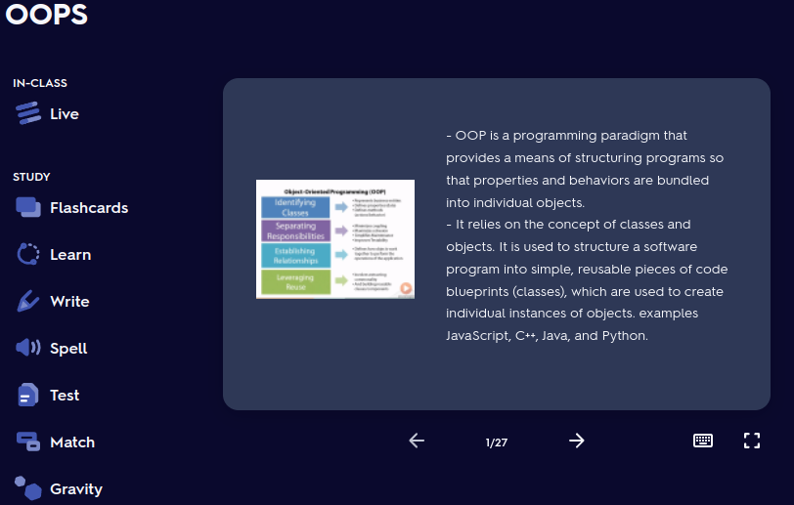
‹#›

Slide 7
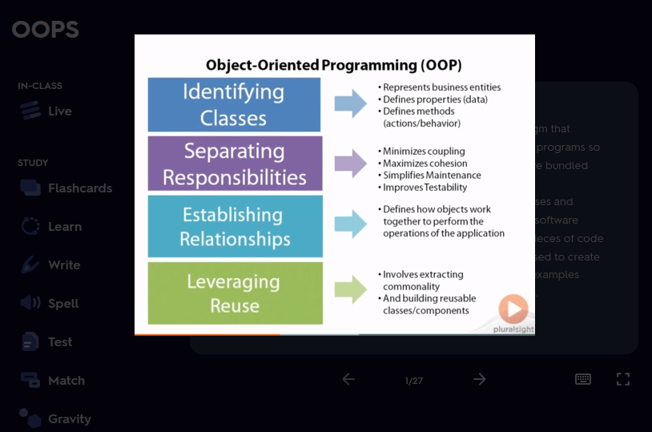
‹#›

Slide 8

What IS flashcard
Flashcards exercise the mental process of active recall: given a prompt (the question), one produces the answer.
Beyond the content of cards, which are collected in decks, there is the question of use – how does one use the cards, in particular, how frequently does one review (more finely, how does one schedule review) and how does one react to errors, either complete failures to recall or mistakes?
Various systems have been developed, mostly based around spaced repetition – increasing the time intervals between reviews whenever a card is recalled correctly.
‹#›

Slide 9
What is spaced repetition
Spaced repetition is an evidence-based learning technique that is usually performed with flashcards.
Newly introduced and more difficult flashcards are shown more frequently, while older and less difficult flashcards are shown less frequently in order to exploit the psychological spacing effect. The use of spaced repetition has been proven to increase the rate of learning.
‹#›

Slide 10
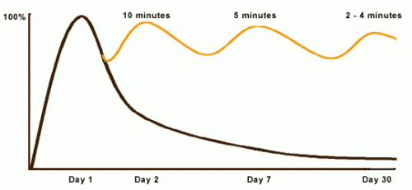
Why do we need spaced repetition
According to the NewYork Bestseller Book ‘Brain Rules’ We forget 90% of what we learnt in 30 days if not revised.
The Curve of forgetting
‹#›

Slide 11
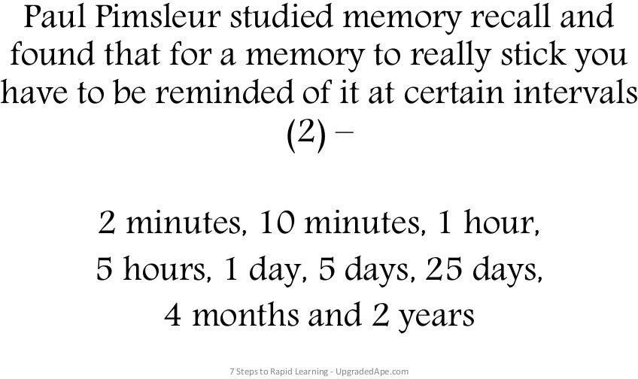

Slide 12
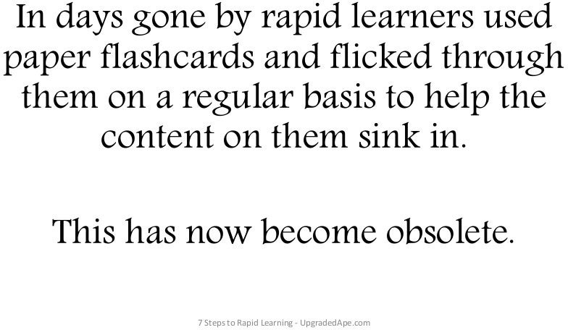

Slide 13
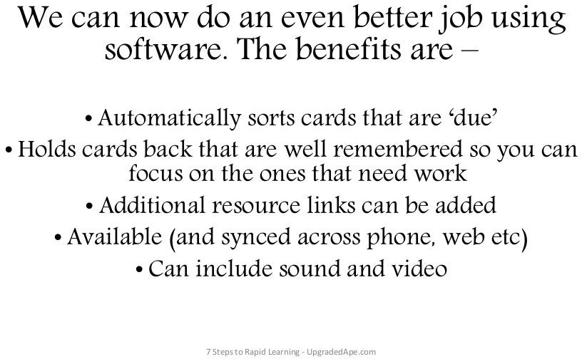

Slide 14
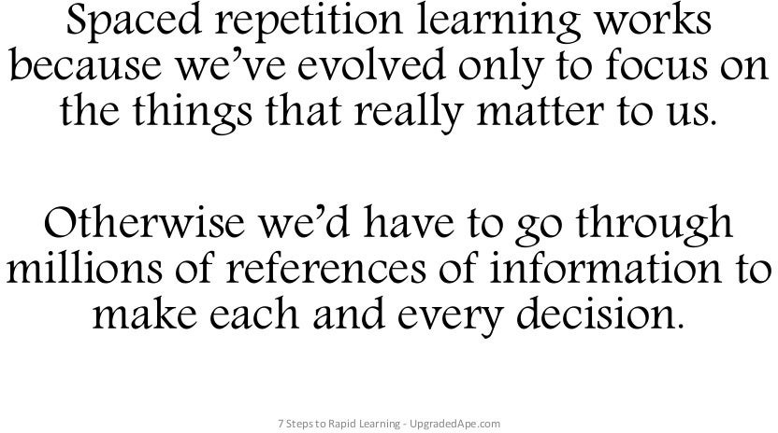

Slide 15
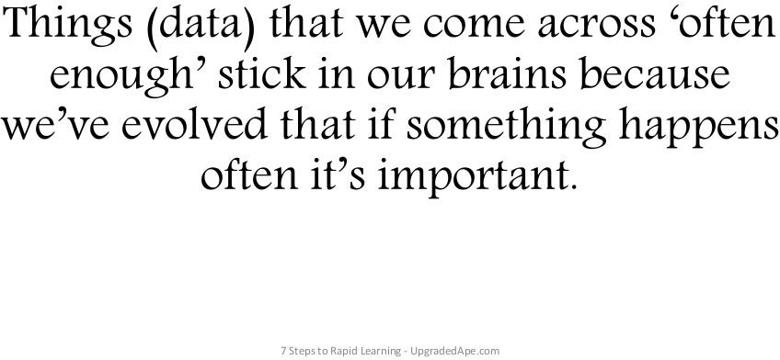

Slide 16
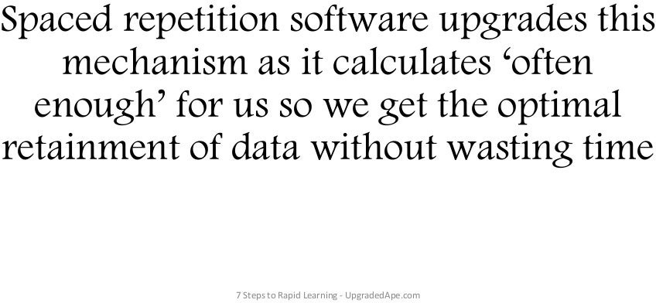

Slide 17
Cost and time estimitation
Estimated time is around 30 to 45 days
Estimated cost is around $0/month for free tier hosting services and $14.35/month for dedicated server and hosting
We can use Netlify/Github pages for static website
We can use Heroku for websites with backend

